Slide 1


Understanding Air Traffic Delays at Vancouver International Airport (YVR)

Slide 2

TEAM MEMBERS

Slide 3
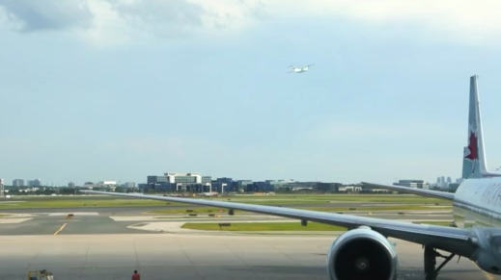


DEPARTURES
Time
Destination
Flight No.
Gate
Remarks

Slide 4

DEPARTURES
DEPARTURES
Time
Destination
Flight No.
Time
Destination
Flight No.
Gate
Remarks
This is a nightmare!
I wish there was a way to forecast flight delays

Slide 5

Forecasting Airflight Delay in YVR Vancouver Airport
Introduction
Workflow overview
Missing Data
EDA
Principal Component Analysis
Factor Analysis
Stepwise regression
Correspondence Analysis
Random Forest
Conclusions
Future
References

Slide 6

Aircraft delays have significant economic repercussions. The average cost of aircraft block time is approximately $100.80 per minute.
Vancouver International Airport (YVR) serves as a critical hub in the Pacific Northwest, handling a substantial volume of air traffic annually.
Analyzing real-world data from YVR allows us to explore the relationship between local weather patterns and flight delays, providing insights that can enhance operational efficiency and passenger experience.

Slide 7
By examining the interplay between weather conditions and flight delays at YVR, we aim to develop predictive models that can assist in proactive decision-making for airlines and airport authorities.
This analysis seeks to contribute to the broader understanding of how environmental factors influence aviation operations, potentially leading to improved scheduling, resource allocation, and overall service quality.

Slide 8





Overview
1. Data Collection
2. Data Loading
3. Exploratory Data Analysis (EDA)
4. Feature Engineering
5. Modeling
Fetching Weather Data via API
Fetching flights Data via API
Joining the datasets
Subset Winter Data
Handling missing data
Data Structure
Distributions
Outliers
PCA
FA
CA
Feature Selection (Stepwise)
Data Splitting (Training and Testing)
Random Forest
Logistic Regression
Model Evaluation

Slide 9
We aimed to work with real-world data, rather than relying on clean, pre-defined datasets.
Our focus was on analyzing information relevant to Canada, particularly the city of Vancouver, which led us to study flight patterns from YVR Airport.
Weather data set
(Open-Meteo API)
Flight data set
(Aviation Edge)
Flight and weather data were merged based on timestamps to align weather conditions with flight schedules.
The merging process ensured accurate representation of weather influences at the time of each flight.

Slide 10
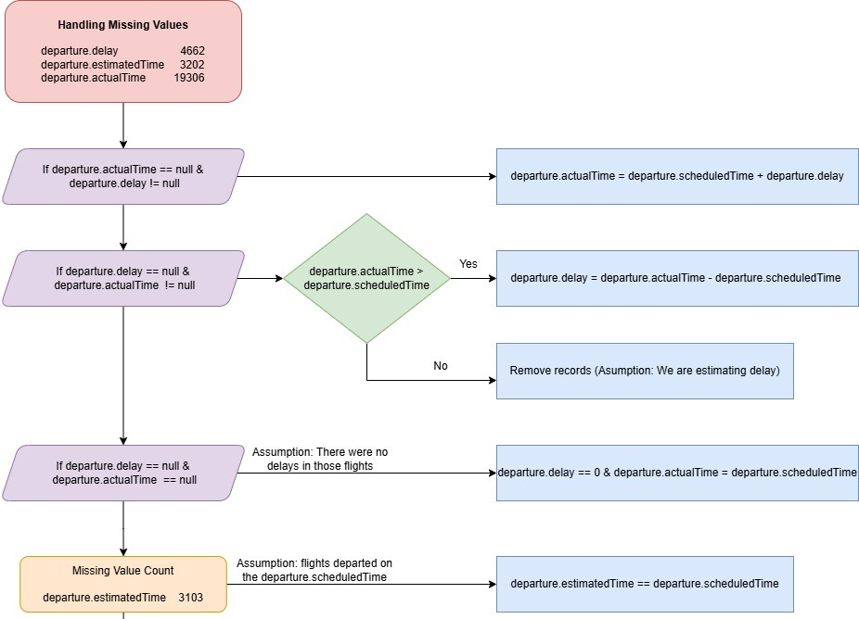
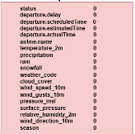
Status:
On time
Delay
Cancelled

Slide 11
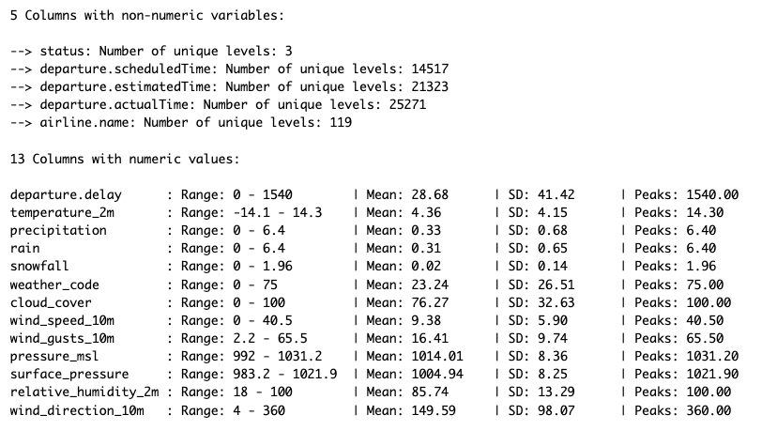
Status:
On time
Delay
Cancelled

Slide 12
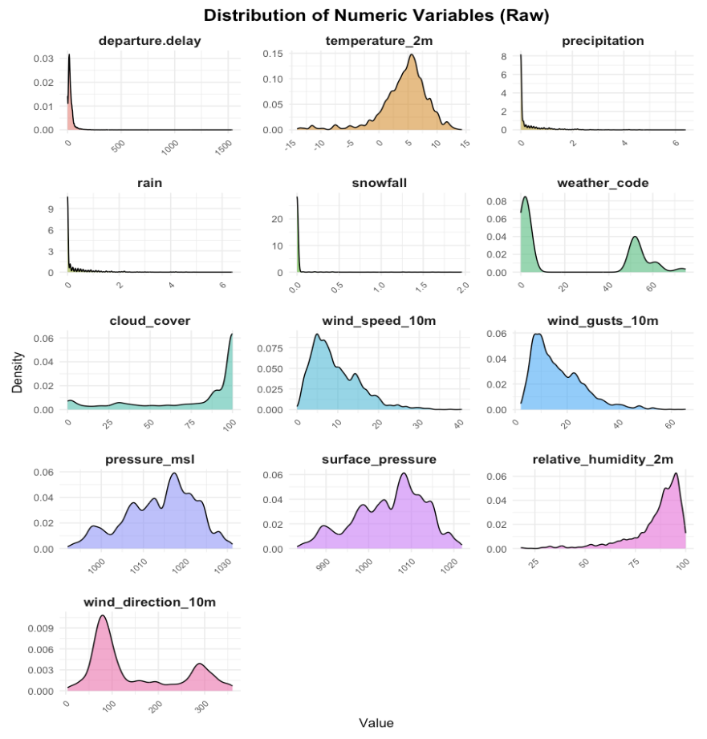
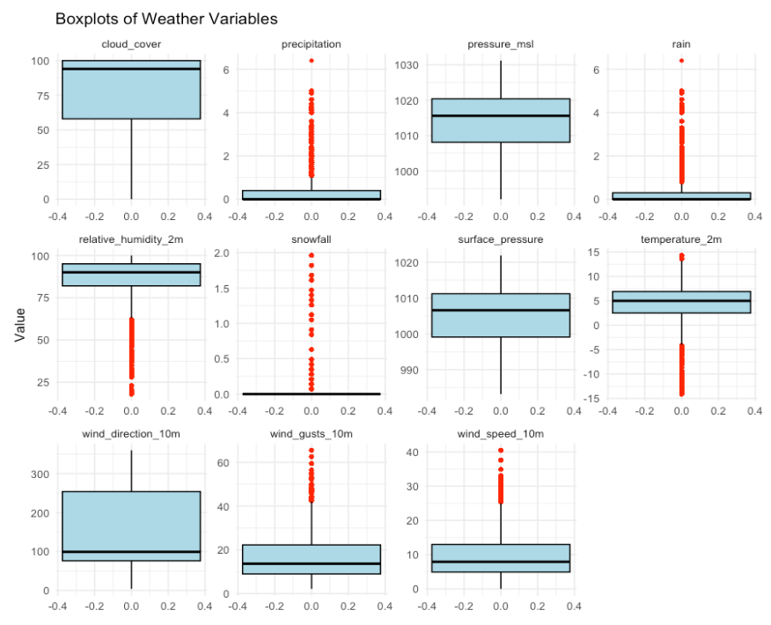
Notes:
According to the distribution of weather conditions we can identify that precipitation, rain, wind_speed_10m, wind_gusts_10m are skewed to the right while relative_humidity_2m, and cloud_cover are skewed to the left. Also, Bimodal distribution present in wind_direction_10m weather condition while other weather conditions pressure_msl, surface_pressure, has multimodal distribution. Only temperature_2m present normal distribution.

Slide 13
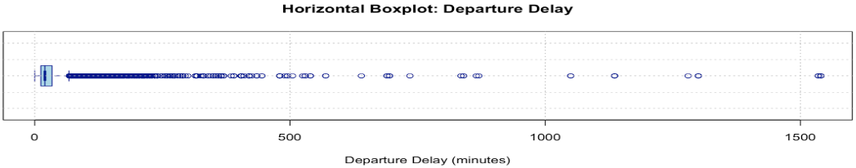
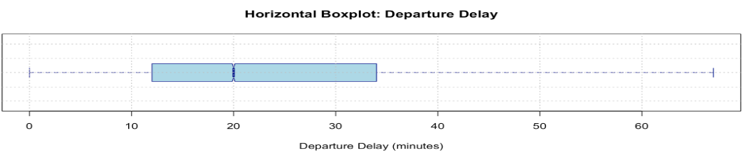
Target variable contains a great deal of outliers.
Most observations fall between 0 and ~70 minutes of delay.
Mean: 28.68 minutes
Median: 20 minutes
Sd: 41.42 minutes

Slide 14
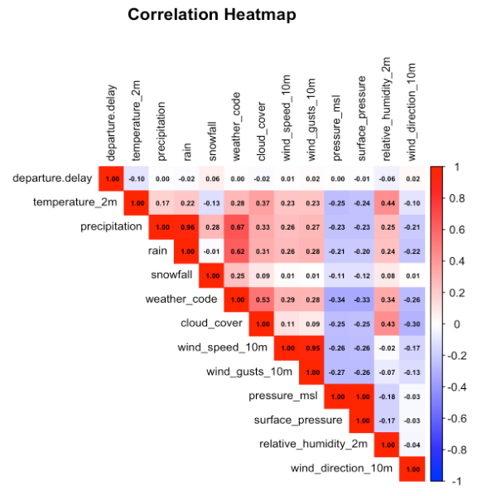
Our variable of interest (departure.delay) shows weak correlations with most variables.
Suggests delays may not be strongly influenced by any single weather variable but could result from a combination of factors.
There are strong correlation between:
precipitation and rain (0.96)
wind_speed_10m and wind_gust_10m (0.95)
pressure_msl and surface_pressure (1)
Notes:
• temperature_2m: Weak negative correlation (-0.10).
• precipitation and rain: Weak positive correlations (~0.22 and 0.21, respectively).
• cloud_cover: Weak positive correlation (0.10).

Slide 15
Purpose
PCA is a dimensionality reduction technique that transforms correlated variables into a smaller set of uncorrelated principal components (PCs) while retaining most of the variance in the data.
Why Apply PCA to Flight Data?
Simplify Complexity: Reduces high-dimensional data into key components for easier analysis.
Identify Key Drivers: Highlights the main factors influencing delays, such as severe weather conditions.
Resolve Correlations: Handles overlapping information in variables like rainfall, snowfall, and wind.
Improve Efficiency: Makes data interpretation and modeling faster and more focused.
PCA helps uncover patterns and relationships while retaining most of the data’s essential information.
Approach
Apply PCA on combined flight and weather data to reduce it to key principal components.
Standardize data
Apply PCA
Visualize the results
Use the reduced components as input for predictive models to classify delay categories.
Identify which components are most predictive of severe delays.

Slide 16
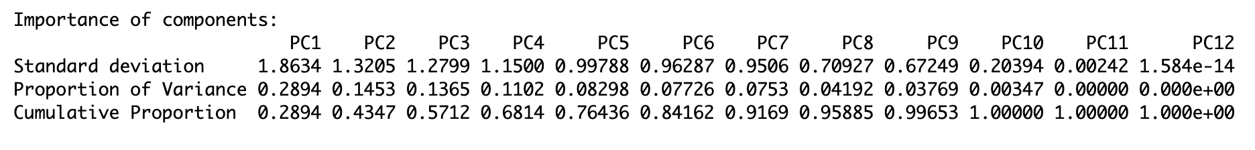
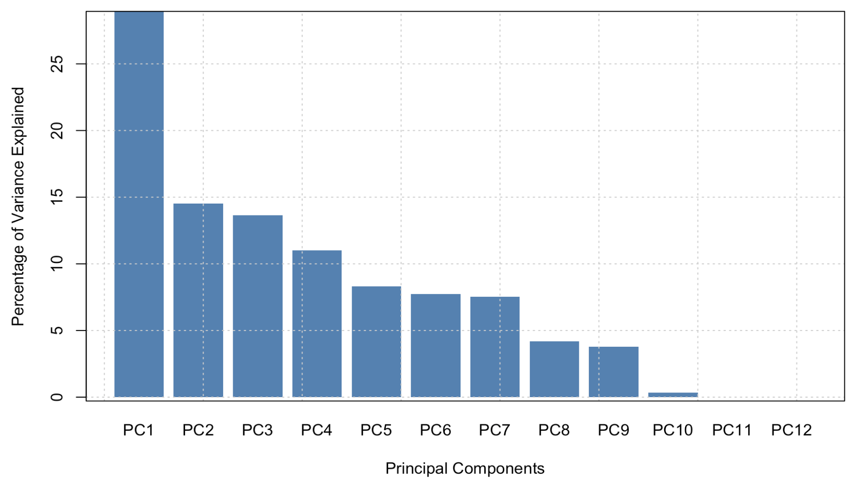
PCA to Predict Flight Delay Severity Categories
We applied PCA on combined flight and weather data to reduce it to key principal components.
PC1 to PC3 are the most important, as they explain more than half of the total variance (57.12%).
PC4 to PC6 add some explanatory value (up to about 84%), but after that, additional components explain a very minimal amount of variance.

Slide 17
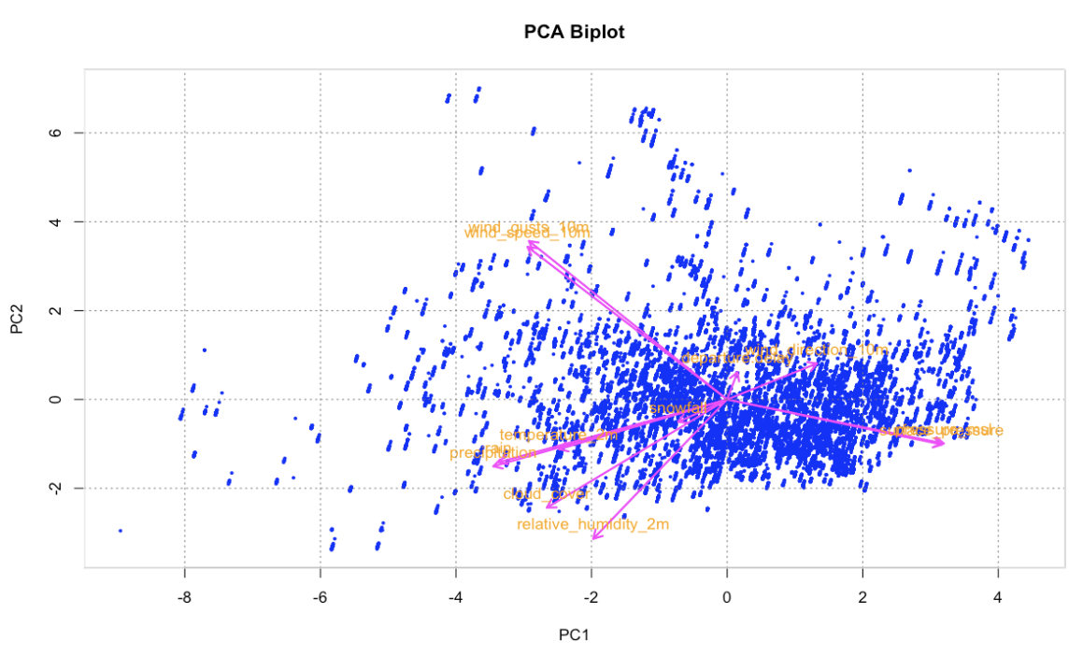
The arrows represent the contributions of each variable to the principal components.
Longer arrows indicate stronger contributions.
Variables like wind_gusts_10m and relative_humidity_2m have higher contributions along this PC1 dimension.

Slide 18

Multinomial Logistic Regression vs. PCA Regression
1. Defining Delay Categories:
No Delay: ≤ 0 minutes.
Short Delay: 1–15 minutes.
Long Delay: 16–60 minutes.
Very Long Delay: > 60 minutes.
2. Data Preparation:
Selected 11 key weather-related predictors.
Created delay_category as a factor variable.
Split dataset: 80% Training, 20% Testing.
Notes:
• temperature_2m: Weak negative correlation (-0.10).
• precipitation and rain: Weak positive correlations (~0.22 and 0.21, respectively).
• cloud_cover: Weak positive correlation (0.10). We categorized delays into four meaningful groups and used multinomial logistic regression to predict delay likelihood. This method allows us to explore how specific weather conditions impact different delay categories. For example, higher temperatures are linked to short and long delays, while snowfall reduces short delays but increases very long delays. Understanding these relationships enables proactive measures in flight operations.
https://www.google.com/url?sa=i&url=https%3A%2F%2Ftribune.com.pk%2Fstory%2F2441950%2Fprivate-airlines-up-fares-as-pia-in-a-fix&psig=AOvVaw2YuTaqD_rO2CIfoy4QAK-J&ust=1732645031565000&source=images&cd=vfe&opi=89978449&ved=0CBQQjRxqFwoTCKjKze-L-IkDFQAAAAAdAAAAABAR

Slide 19
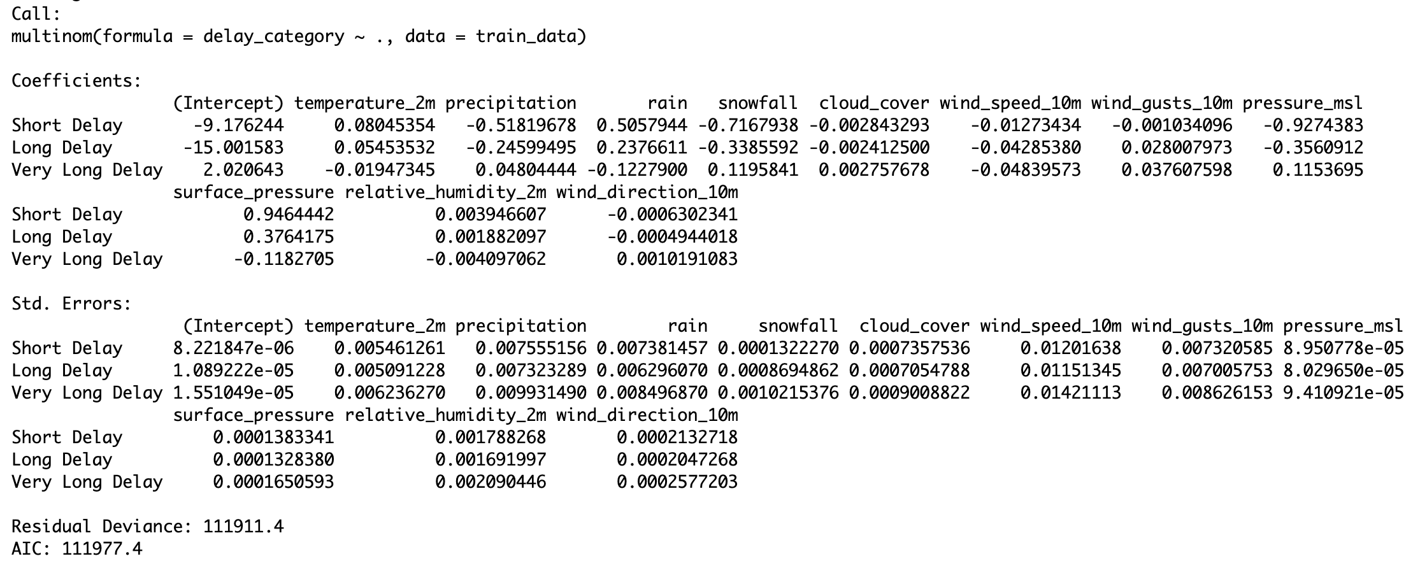
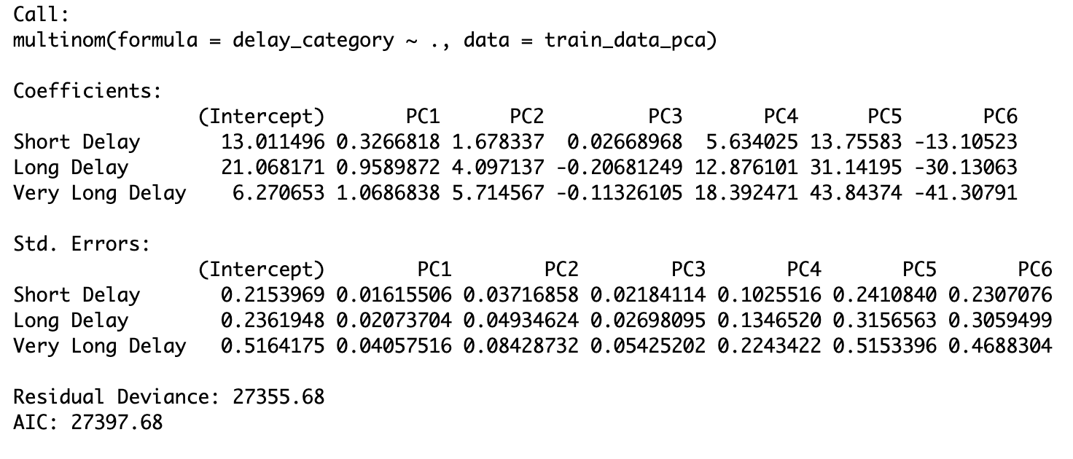
Multinomial Logistic Regression
AIC: 111977.4
Variables: all
PCA Regression
AIC: 27397.68
PC: 6
Notes:
The coefficient represent the effect of the predictor variable on the log-odds of being in a particular delay category ("Short Delay," "Long Delay," or "Very Long Delay") compared to the baseline category ("No Delay").
Positive coefficients indicate that as the predictor variable increases, the likelihood of being in the specific delay category (compared to the baseline) increases while negative coefficients suggest otherwise.
Important factors can be found in the result:
* Temperature_2m: The coefficients are positive for Short Delay and Long Delay, meaning higher temperatures are associated with these delay categories.
* Precipitation, Rain, and Snowfall: These weather factors have both positive and negative impacts on different delay categories.
* Snowfall has a significant negative coefficient for Short Delay, implying it decreases the likelihood of shorter delays but might increase Very Long Delays.
* Wind Gusts (wind_gusts_10m): Shows positive coefficients, suggesting that stronger wind gusts might increase the likelihood of delays.
* Pressure (pressure_msl) and surface_pressure : It's coefficients vary but seem relatively strong, which could indicate it plays an important role.
The standard errors (listed below the coefficients) indicate the variability in the coefficient estimates. Smaller standard errors mean the coefficient estimates are more precise. For example, the standard error for temperature_2m for "Short Delay" is small (0.005489562), suggesting a more precise estimate.

Slide 20
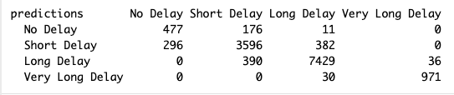


Logistic Regression
Accuracy: 0.984
We can identify imbalances in class-specific predictions. For example, "Short Delay" and "Long Delay" dominate the dataset, which may affect predictions for smaller classes like "No Delay" and "Very Long Delay.
Notes:
*No Delay* Correct predictions: 457, while 284 observations were misclassified as "Short Delay". Accuracy for "No Delay" seems low, suggesting challenges in distinguishing it from "Short Delay."
*Short Delay* Correct predictions: 3603, Most misclassifications are as "Long Delay" (439) or "No Delay" (134).
*Long Delay* Dominates the dataset (7370 correctly classified), with some confusion with "Short Delay" (406) and minor misclassifications as "Very Long Delay" (38).
*Very Long Delay* High precision for this class (993 correct predictions), with only 58 misclassifications as "Long Delay."
The confusion matrix reflects imbalances in class-specific predictions. For example, "Short Delay" and "Long Delay" dominate the dataset, which may affect predictions for smaller classes like "No Delay" and "Very Long Delay.

Slide 21
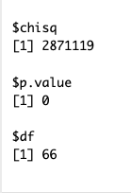
Purpose
Understand which weather factors contribute the most to flight delays
Approach
Apply Factor Analysis on weather variables
Extract factors that group correlated variables,
Analyze which factor loadings have the strongest influence on departure delays.
Weather Impact Analysis on Delays Using FA
Applyed Bartlett’s test to evaluate whether the correlation matrix of the variables is an identity matrix.
A significant result indicates that there are meaningful correlations, making the data suitable for techniques like factor analysis or PCA.

Slide 22
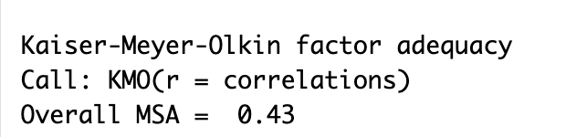
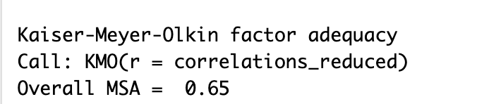
(KMO) test result suggests low sampling adequacy for the weather variables (<0.5), indicating that these variables are not suitable for factor analysis (FA).
To address that we removed highly correlated variables and checked for the KMO.
Before removing variables
After removing variables

Slide 23
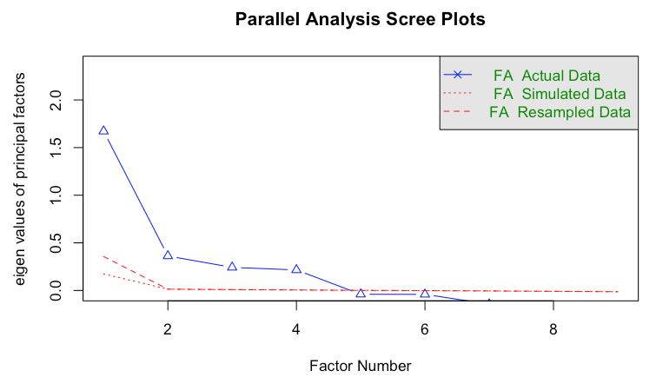
We selected 4 factors based on the results.

Slide 24
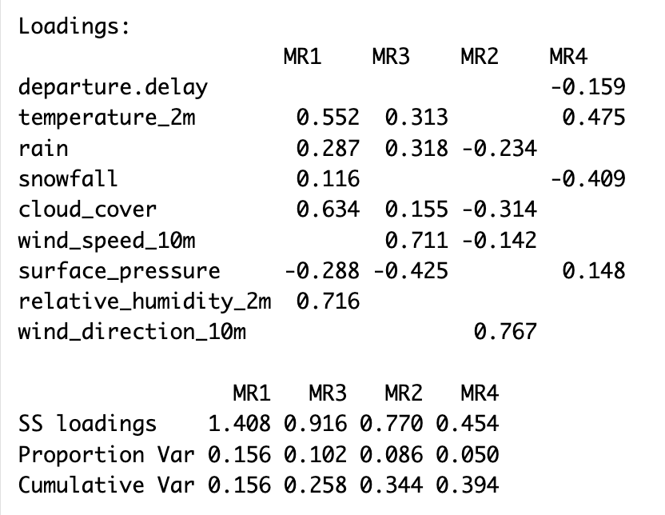
MR1 explains 15.6% of the variance, MR3 explains 10.2%, MR2 explains 8.6%, and MR4 explains 5.0%. Together, these factors account for about 39.4% of the variance in the dataset, meaning they provide a moderate summary of the weather data’s variability.
This factor analysis suggests that temperature and humidity (MR1), wind speed (MR3), wind direction (MR2), and snowfall (MR4) are the primary weather conditions associated with delay.

Slide 25
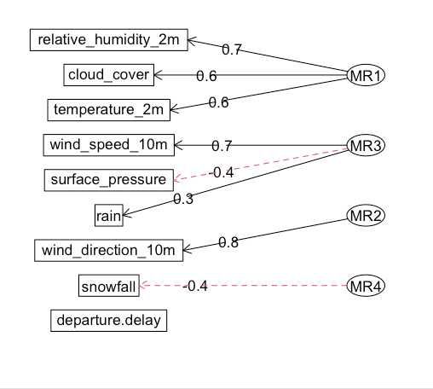
Factor MR1 (Primary Weather Factor): This factor represents temperature and humidity conditions. High loadings suggest that MR1 relates to general atmospheric conditions.
Factor MR3: could represent wind-related weather conditions. The presence of wind_speed_10m as a strong contributor indicates this factor may capture the impact of wind on flight delays.
Factor MR2: represents wind direction specifically. High variance in wind_direction could impact flight schedules, especially departures and arrivals.
Factor MR4: appears to capture precipitation specific weather conditions, particularly snowfall, which can directly impact flights due to runway conditions and visibility.
Notes:
• temperature_2m: Weak negative correlation (-0.10).
• precipitation and rain: Weak positive correlations (~0.22 and 0.21, respectively).
• cloud_cover: Weak positive correlation (0.10). We categorized delays into four meaningful groups and used multinomial logistic regression to predict delay likelihood. This method allows us to explore how specific weather conditions impact different delay categories. For example, higher temperatures are linked to short and long delays, while snowfall reduces short delays but increases very long delays. Understanding these relationships enables proactive measures in flight operations.
https://www.google.com/url?sa=i&url=https%3A%2F%2Ftribune.com.pk%2Fstory%2F2441950%2Fprivate-airlines-up-fares-as-pia-in-a-fix&psig=AOvVaw2YuTaqD_rO2CIfoy4QAK-J&ust=1732645031565000&source=images&cd=vfe&opi=89978449&ved=0CBQQjRxqFwoTCKjKze-L-IkDFQAAAAAdAAAAABAR

Slide 26
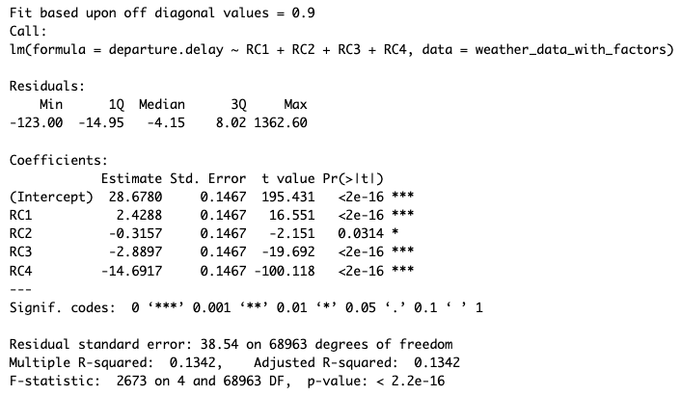
Regression Analysis with Factors as Predictors for departure delay
The Multiple R-squared of 0.1342 means that the model explains around 13.4% of the variance in departure.delay using these four factors.
Given the Residual Standard Error of 38.54, there remains substantial unexplained variance, which may be due to other factors not captured by the four components or other types of delays (e.g., airline or airport factors).
Notes:
• temperature_2m: Weak negative correlation (-0.10).
• precipitation and rain: Weak positive correlations (~0.22 and 0.21, respectively).
• cloud_cover: Weak positive correlation (0.10). We categorized delays into four meaningful groups and used multinomial logistic regression to predict delay likelihood. This method allows us to explore how specific weather conditions impact different delay categories. For example, higher temperatures are linked to short and long delays, while snowfall reduces short delays but increases very long delays. Understanding these relationships enables proactive measures in flight operations.
https://www.google.com/url?sa=i&url=https%3A%2F%2Ftribune.com.pk%2Fstory%2F2441950%2Fprivate-airlines-up-fares-as-pia-in-a-fix&psig=AOvVaw2YuTaqD_rO2CIfoy4QAK-J&ust=1732645031565000&source=images&cd=vfe&opi=89978449&ved=0CBQQjRxqFwoTCKjKze-L-IkDFQAAAAAdAAAAABAR

Slide 27
Purpose of Stepwise
Stepwise regression is a method to iteratively add/remove variables to build the best predictive model.
In flight delay analysis, it identifies key factors (e.g., weather, traffic, airline) that most influence delays.
1.⁠ ⁠Full Model Setup:
Created a formula incorporating all potential predictors of departure delays: temperature, precipitation, wind, pressure, humidity, etc.
Fitted the full model using lm() to include all variables.
2.⁠ ⁠Stepwise Regression:
Applied stepwise selection using the stepAIC() function with the direction set to "both".
This approach iteratively:
Removes less significant variables (backward elimination).
Adds significant variables not initially included (forward selection).
Notes:
• temperature_2m: Weak negative correlation (-0.10).
• precipitation and rain: Weak positive correlations (~0.22 and 0.21, respectively).
• cloud_cover: Weak positive correlation (0.10). We categorized delays into four meaningful groups and used multinomial logistic regression to predict delay likelihood. This method allows us to explore how specific weather conditions impact different delay categories. For example, higher temperatures are linked to short and long delays, while snowfall reduces short delays but increases very long delays. Understanding these relationships enables proactive measures in flight operations.
https://www.google.com/url?sa=i&url=https%3A%2F%2Ftribune.com.pk%2Fstory%2F2441950%2Fprivate-airlines-up-fares-as-pia-in-a-fix&psig=AOvVaw2YuTaqD_rO2CIfoy4QAK-J&ust=1732645031565000&source=images&cd=vfe&opi=89978449&ved=0CBQQjRxqFwoTCKjKze-L-IkDFQAAAAAdAAAAABAR

Slide 28
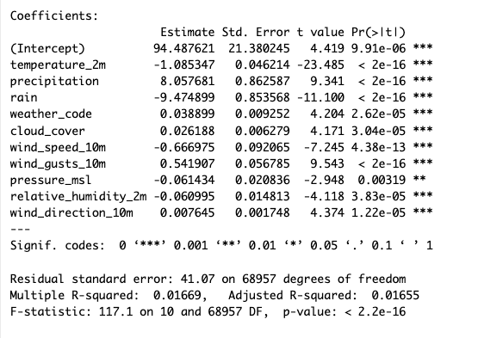
The final model after stepwise regression includes 10 predictors.
Only 1.67% of the variation in departure.delay is explained by the predictors. This is very low, indicating a weak model fit.
The low R-squared indicates other factors (e.g., operational delays, human error) likely influence departure.delay.
The recommendation in this case is to use non-linear modeling techniques (e.g., random forests, GAMs) for better predictions if relationships are non-linear.
Notes:
• temperature_2m: Weak negative correlation (-0.10).
• precipitation and rain: Weak positive correlations (~0.22 and 0.21, respectively).
• cloud_cover: Weak positive correlation (0.10). We categorized delays into four meaningful groups and used multinomial logistic regression to predict delay likelihood. This method allows us to explore how specific weather conditions impact different delay categories. For example, higher temperatures are linked to short and long delays, while snowfall reduces short delays but increases very long delays. Understanding these relationships enables proactive measures in flight operations.
https://www.google.com/url?sa=i&url=https%3A%2F%2Ftribune.com.pk%2Fstory%2F2441950%2Fprivate-airlines-up-fares-as-pia-in-a-fix&psig=AOvVaw2YuTaqD_rO2CIfoy4QAK-J&ust=1732645031565000&source=images&cd=vfe&opi=89978449&ved=0CBQQjRxqFwoTCKjKze-L-IkDFQAAAAAdAAAAABAR

Slide 29

Purpose
Is used to explore relationships between flight delays and weather conditions (snowfall, rain, wind speed).
To visualize trends and dependencies between delay categories (e.g., "Long Delay") and specific weather conditions (e.g., "Heavy Snowfall").
To simplify and interpret patterns in complex, multidimensional data.
Why convert numerical variables to categorical?
Interpretability: categories like "Heavy Snow" or "Very Windy" are easier to understand than raw numerical values.
Suitability for CA: requires categorical data.
Highlights meaningful thresholds (heavy snow increases delays) for stakeholders.
Importance
CA helps reveal actionable insights into how weather impacts flight delays, offering a visual and interpretable summary for decision-making and analysis.
Notes:
• temperature_2m: Weak negative correlation (-0.10).
• precipitation and rain: Weak positive correlations (~0.22 and 0.21, respectively).
• cloud_cover: Weak positive correlation (0.10). We categorized delays into four meaningful groups and used multinomial logistic regression to predict delay likelihood. This method allows us to explore how specific weather conditions impact different delay categories. For example, higher temperatures are linked to short and long delays, while snowfall reduces short delays but increases very long delays. Understanding these relationships enables proactive measures in flight operations.
https://www.google.com/url?sa=i&url=https%3A%2F%2Ftribune.com.pk%2Fstory%2F2441950%2Fprivate-airlines-up-fares-as-pia-in-a-fix&psig=AOvVaw2YuTaqD_rO2CIfoy4QAK-J&ust=1732645031565000&source=images&cd=vfe&opi=89978449&ved=0CBQQjRxqFwoTCKjKze-L-IkDFQAAAAAdAAAAABAR

Slide 30
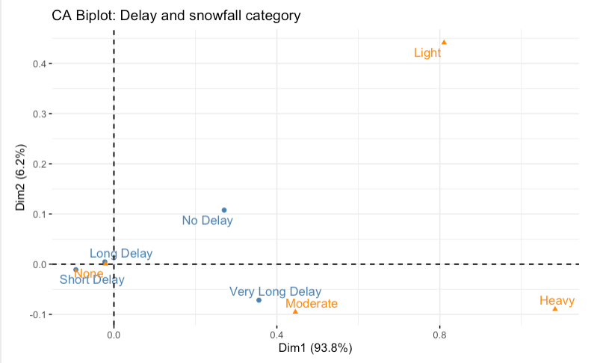
Snowfall
Heavier snowfall has a higher association with longer delays.
Most flights with no delay experience no snowfall, but long delays and very long delays increase when snowfall increased from Moderate to Heavy.
Notes:
• temperature_2m: Weak negative correlation (-0.10).
• precipitation and rain: Weak positive correlations (~0.22 and 0.21, respectively).
• cloud_cover: Weak positive correlation (0.10). We categorized delays into four meaningful groups and used multinomial logistic regression to predict delay likelihood. This method allows us to explore how specific weather conditions impact different delay categories. For example, higher temperatures are linked to short and long delays, while snowfall reduces short delays but increases very long delays. Understanding these relationships enables proactive measures in flight operations.
https://www.google.com/url?sa=i&url=https%3A%2F%2Ftribune.com.pk%2Fstory%2F2441950%2Fprivate-airlines-up-fares-as-pia-in-a-fix&psig=AOvVaw2YuTaqD_rO2CIfoy4QAK-J&ust=1732645031565000&source=images&cd=vfe&opi=89978449&ved=0CBQQjRxqFwoTCKjKze-L-IkDFQAAAAAdAAAAABAR

Slide 31
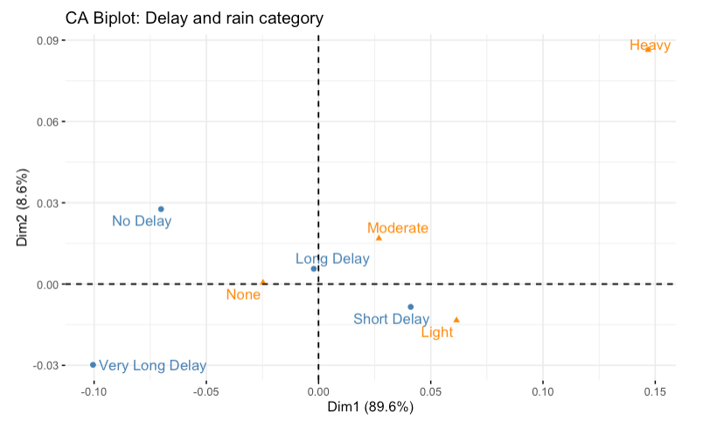
Rain
Light rain and moderate rain have association with delays, although the effect is less pronounced than snowfall.
One example is that long delays are most frequent in light rain conditions, rather than moderate or heavy.
Notes:
• temperature_2m: Weak negative correlation (-0.10).
• precipitation and rain: Weak positive correlations (~0.22 and 0.21, respectively).
• cloud_cover: Weak positive correlation (0.10). We categorized delays into four meaningful groups and used multinomial logistic regression to predict delay likelihood. This method allows us to explore how specific weather conditions impact different delay categories. For example, higher temperatures are linked to short and long delays, while snowfall reduces short delays but increases very long delays. Understanding these relationships enables proactive measures in flight operations.
https://www.google.com/url?sa=i&url=https%3A%2F%2Ftribune.com.pk%2Fstory%2F2441950%2Fprivate-airlines-up-fares-as-pia-in-a-fix&psig=AOvVaw2YuTaqD_rO2CIfoy4QAK-J&ust=1732645031565000&source=images&cd=vfe&opi=89978449&ved=0CBQQjRxqFwoTCKjKze-L-IkDFQAAAAAdAAAAABAR

Slide 32
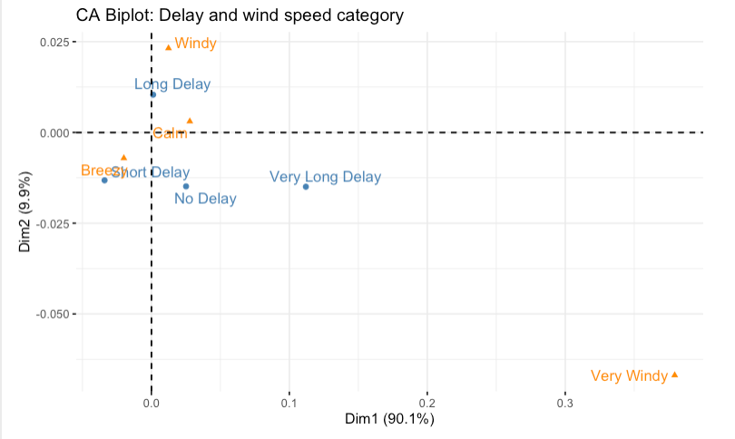
Wind Speed
Breezy and windy conditions are linked to longer delays, with short delays and long delays being common in these wind conditions.
In summary, snowfall has the strongest association with longer delays, followed by wind speed and rain.
Notes:
• temperature_2m: Weak negative correlation (-0.10).
• precipitation and rain: Weak positive correlations (~0.22 and 0.21, respectively).
• cloud_cover: Weak positive correlation (0.10). We categorized delays into four meaningful groups and used multinomial logistic regression to predict delay likelihood. This method allows us to explore how specific weather conditions impact different delay categories. For example, higher temperatures are linked to short and long delays, while snowfall reduces short delays but increases very long delays. Understanding these relationships enables proactive measures in flight operations.
https://www.google.com/url?sa=i&url=https%3A%2F%2Ftribune.com.pk%2Fstory%2F2441950%2Fprivate-airlines-up-fares-as-pia-in-a-fix&psig=AOvVaw2YuTaqD_rO2CIfoy4QAK-J&ust=1732645031565000&source=images&cd=vfe&opi=89978449&ved=0CBQQjRxqFwoTCKjKze-L-IkDFQAAAAAdAAAAABAR

Slide 33
Purpose
A machine learning algorithm that builds multiple decision trees and combines their outputs for better accuracy and robustness. It is used for both classification and regression tasks.
Why Good for Flight Delay Analysis?
Handles numerous predictors like weather, time, and location.
Captures interactions between variables without manual feature engineering.
Delivers reliable predictions and insights into key delay factors.
Approach
Define the Delay Categories
Prepare the Reduced Principal Components
Split the Data into Training and Test Sets (70% train and 30% for test)
Train a Predictive Model
Make Predictions on the Test Set
Evaluate Model Performance
Notes:
• temperature_2m: Weak negative correlation (-0.10).
• precipitation and rain: Weak positive correlations (~0.22 and 0.21, respectively).
• cloud_cover: Weak positive correlation (0.10). We categorized delays into four meaningful groups and used multinomial logistic regression to predict delay likelihood. This method allows us to explore how specific weather conditions impact different delay categories. For example, higher temperatures are linked to short and long delays, while snowfall reduces short delays but increases very long delays. Understanding these relationships enables proactive measures in flight operations.
https://www.google.com/url?sa=i&url=https%3A%2F%2Ftribune.com.pk%2Fstory%2F2441950%2Fprivate-airlines-up-fares-as-pia-in-a-fix&psig=AOvVaw2YuTaqD_rO2CIfoy4QAK-J&ust=1732645031565000&source=images&cd=vfe&opi=89978449&ved=0CBQQjRxqFwoTCKjKze-L-IkDFQAAAAAdAAAAABAR

Slide 34
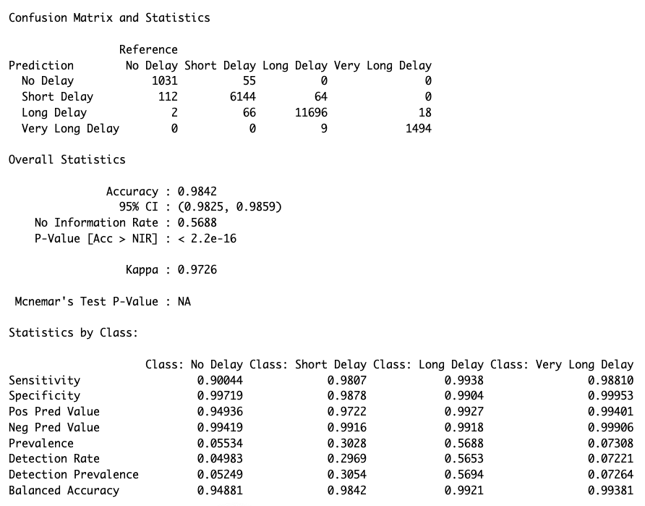
The accuracy is 0.9843 (98.43%), indicates model is highly accurate in predicting the delay categories.
The Kappa value of 0.9728 indicates excellent agreement between the predicted and actual categories beyond chance.
Sensitivity: very high values for all classes, particularly "Long Delay" (99.40%) and "Very Long Delay" (98.74%), indicating strong identification capabilities.
Specificity: values are high for all the classes, suggesting that the model avoids misclassifying other classes as a given class.
Notes:
• temperature_2m: Weak negative correlation (-0.10).
• precipitation and rain: Weak positive correlations (~0.22 and 0.21, respectively).
• cloud_cover: Weak positive correlation (0.10). We categorized delays into four meaningful groups and used multinomial logistic regression to predict delay likelihood. This method allows us to explore how specific weather conditions impact different delay categories. For example, higher temperatures are linked to short and long delays, while snowfall reduces short delays but increases very long delays. Understanding these relationships enables proactive measures in flight operations.
https://www.google.com/url?sa=i&url=https%3A%2F%2Ftribune.com.pk%2Fstory%2F2441950%2Fprivate-airlines-up-fares-as-pia-in-a-fix&psig=AOvVaw2YuTaqD_rO2CIfoy4QAK-J&ust=1732645031565000&source=images&cd=vfe&opi=89978449&ved=0CBQQjRxqFwoTCKjKze-L-IkDFQAAAAAdAAAAABAR

Slide 35
Mean Decrease Accuracy:
PC5 has the highest impact on accuracy, followed by PC6, meaning these components contribute the most to the model's predictions.
Components like PC3 have the least impact, suggesting they add less value to the model in terms of predictive accuracy.
Mean Decrease Gini:
PC5 shows the highest contribution to reducing impurity, followed by PC6, and again PC3 shows the least impact.
Notes:
The plot shows the variable importance metrics for the Random Forest model (rf_model) based on principal components (PC1 to PC6) used as features.
Interpretation:
MeanDecreaseAccuracy:
This metric indicates how much the model's accuracy decreases when a particular principal component (PC) is excluded from the model.
PC5 has the highest impact on accuracy, followed by PC6, meaning these components contribute the most to the model's predictions.
Components like PC3 have the least impact, suggesting they add less value to the model in terms of predictive accuracy.
MeanDecreaseGini:
This metric measures the decrease in node impurity (based on the Gini Index) when a specific principal component is used for splitting.
Similar to the accuracy metric, PC5 shows the highest contribution to reducing impurity, followed by PC6, and again PC3 shows the least impact.
Insights:
PC5 and PC6 are the most significant components for predicting flight delays, indicating that the variables represented in these components (e.g., weather-related factors) play a critical role in determining outcomes.
PC3 is the least impactful, suggesting it contributes minimally to the prediction process.
Actionable Conclusion:
To improve the model's performance or simplify it further, focus on the top contributing components (PC5 and PC6) and consider excluding lower-impact components like PC3 if necessary, provided it does not significantly affect the model's predictive power.
We categorized delays into four meaningful groups and used multinomial logistic regression to predict delay likelihood. This method allows us to explore how specific weather conditions impact different delay categories. For example, higher temperatures are linked to short and long delays, while snowfall reduces short delays but increases very long delays. Understanding these relationships enables proactive measures in flight operations.
https://www.google.com/url?sa=i&url=https%3A%2F%2Ftribune.com.pk%2Fstory%2F2441950%2Fprivate-airlines-up-fares-as-pia-in-a-fix&psig=AOvVaw2YuTaqD_rO2CIfoy4QAK-J&ust=1732645031565000&source=images&cd=vfe&opi=89978449&ved=0CBQQjRxqFwoTCKjKze-L-IkDFQAAAAAdAAAAABAR

Slide 36
This work demonstrates the powerful synergy between classification and dimension reduction techniques for predicting flight delays influenced by weather conditions.
Random Forest emerged as the best-performing model, achieving high accuracy and balanced metrics across all delay categories, leveraging its ability to handle complex, non-linear relationships and interactions between variables.
Multinomial Logistic Regression provided interpretability, showcasing the impact of specific weather factors on delay categories, but lacked the predictive robustness of Random Forest.
Dimension reduction techniques like Principal Component Analysis (PCA) and Factor Analysis (FA) played a crucial role in simplifying the dataset, retaining significant variability, and uncovering latent relationships.
PCA efficiently reduced dimensionality, enabling computationally efficient and accurate Random Forest predictions, while FA revealed deeper causal connections, offering valuable insights into how weather patterns influence delays.

Slide 37

Weather variables such as temperature, precipitation, rain, snowfall, wind speed, and humidity significantly influence flight delays.
The analysis demonstrated strong relationships between weather conditions and delay categories, with key variables showing high coefficients in both logistic regression and random forest models.
Among the tested models, Random Forest provided the best overall performance, achieving a high accuracy of 98.39%.
Random Forest model can be deployed as a real-time prediction tool, alerting airlines and passengers about potential delays based on forecasted weather conditions.

Slide 38

Incorporate additional features such as air traffic volume, runway availability, technical and operational disruptions, and historical delay patterns to improve model performance.
Perform hyperparameter tuning on the Random Forest model to optimize its predictive capabilities.
A future approach could involve applying the same analysis to different seasons of the year as well as different airports with more extreme weather conditions, where the impact of variables like snowfall, rain, and wind on flight delays may be more pronounced.
This could provide deeper insights into how severe weather patterns influence delays and reveal stronger relationships between weather factors and operational challenges in such regions.

Slide 39

Aviation Edge. (n.d.). Aviation Edge - Database and API. Retrieved November 25, 2024, from https://aviation-edge.com/
Mamdouh, M., Ezzat, M., & Hefny, H. A. (2023). A novel intelligent approach for flight delay prediction. Journal of Big Data, 10, Article 179.
Open-Meteo. (n.d.). Open-Meteo API Documentation. Retrieved November 25, 2024, from https://open-meteo.com/en/docs
Sternberg, A., Soares, J., Carvalho, D., & Ogasawara, E. (2017). A review on flight delay prediction. arXiv preprint arXiv:1703.06118.
Tang, Y. (2021). Airline flight delay prediction using machine learning models. In Proceedings of the 2021 5th International Conference on E-Business and Internet (pp. 7-13).
Yazdi, M. F., Kamel, S. R., Chabok, S. J. M., & Kheirabadi, M. (2020). Flight delay prediction based on deep learning and Levenberg-Marquardt algorithm. Journal of Big Data, 7, Article 106.

Slide 40
TEAM MEMBERS

